Slide 1


Slide 2
Table of contents
Product features
Research and Assumptions
Pricing Structure
Marketing Strategies
Risk Management
Key Performance Indicators

Slide 3
Product features
Our model contains four types of premium packages
Mid-tier with full-replacement
Mid-tier without full-replacement
Premium with full-replacement
Premium without full-replacement
Our claim frequency is limited to 3 times per year in order to prevent any unreasonable claims.

Slide 4
Research and Assumptions
Men are 60% more likely to need full replacements or battery repair than women.
Women are 3.5% more likely to need screen repair than men.
People between ages 18-25 are 16% more likely to need full replacements or screen repair.
Sources: Puls, PC Magazine

Slide 5
Pricing Structure
Yearly Premium
- Expected loss payment*
+ Deductible ($50)
- Corporate expense**
- Shipment fee ($20)
= Expected profit (set at 8%)
*Expected loss: Customer’s probability of damaging phone multiplied by the cost of repair.
Example: Male age 18-25, mid-tier phone warranty without full-replacement.
Cracked screen: 49.28% * $150 = $73.92
Battery failure: 18.29% * $125 = $22.87
Other failures: 26.8% * $100 = $26.80
Total expected loss: $73.92 + $22.87 + $26.80 = $123.59
**Corporate expense: includes utilities, employee salaries, office supplies - set at 10% of premium per contract.

Slide 6
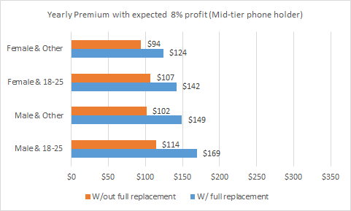
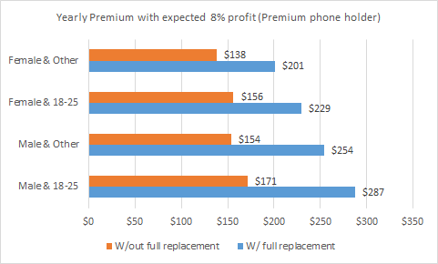
Yearly Premium
- Expected loss payment
+ Deductible ($50)
- Corporate expense
- Shipment fee ($20)
= Expected profit (set at 8%)
Male, age 18-25:
$114 - $123.59 + $50 - (10% * $114) - $20
= $9.01 (Profit, 8% * Premium)

Slide 7
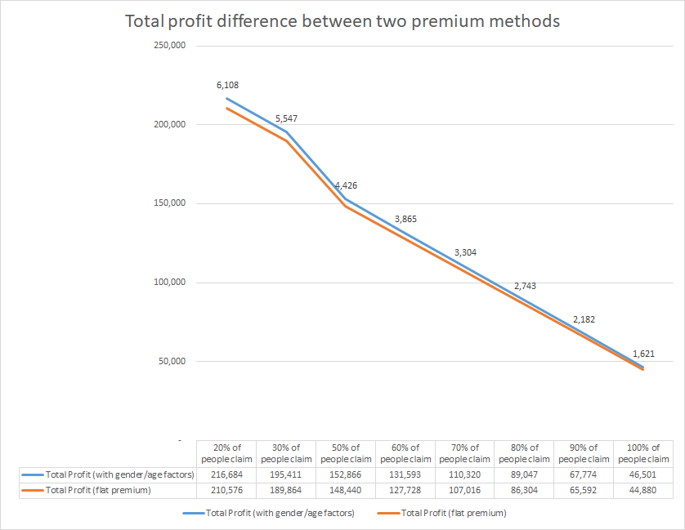

Slide 8
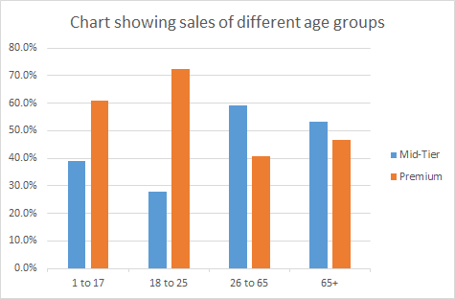
Marketing Strategies
Students under the age of 25 can claim a 10% discount on warranty without replacement for both mid-tier and premium policies.
Veterans and senior citizens above 55 can claim a 15% discount on both mid-tier and premium warranty policies without replacement.

Slide 9
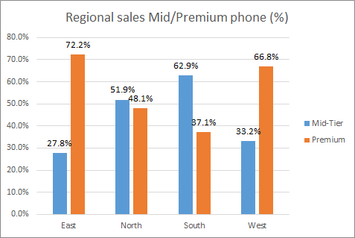
Purchase of the Premium package during the purchase of premium mobile phone in East and West regions gets a coupon of $10 that can be used for any additional/next purchase within 90 days on any D-mobile item that can be claimed during checkout.

Slide 10
Risk management
Analyze and avoid the loss causing activities.
Invest in Enterprise Risk Management strategy.
Safeguarding from Cybersecurity threats such as Data breach.
Improving communication with the shipping facility and offering order tracking services to the customers can help in avoiding shipping risks.

Slide 11
Key Performance Indicators
Success & Sales metrics:
Sales Growth Rate
Retention Rate
Insurance claims metrics:
Average time to settle a claim
Claims frequency
Claims ratio
Financial metrics:
Loss ratio
Net profit margin

Slide 12
Q & A

